Slide 1
Youtube Network Analysis
Jeff Preston, Nathan Shine , Nolen Young, Suhwan Lee

Slide 2
What’s the problem?
Efficiently store, analyze, and interpret data obtained from a crawl of the YouTube network.
Desired results of our project:
Network Aggregation:
Degree Distribution: find the in-degree, out-degree, average degree, maximum and minimum degree.
Categorized Statistics: find the frequency of videos of a given partition such as a videos view count, file size, categorization, and more.
Search:
Top-k queries: find the top-k categories with the most videos, top-k rated videos, and top-k most popular videos
Range queries: find videos with a length in a certain range, and videos in a certain range of file size
User ID in recommendation patterns: find all occurrence of a specified subgraph pattern connecting users and videos with specified search condition.
Influence Analysis:
PageRank: Calculate PageRank scores and find most influential videos

Slide 3
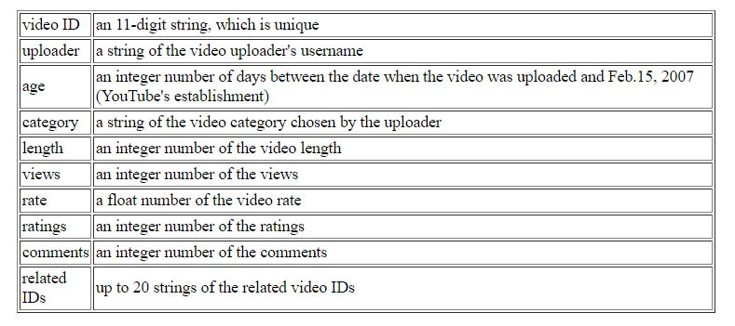
The Data
Data was collected by running multiple crawls across the YouTube network. http://netsg.cs.sfu.ca/youtubedata/
Normal Crawl: data containing video id, upload, age, category, etc.
Updating Crawl: same data but keeps track of the same videos over time
Video File Size and Bitrate: crawl that gathered data on file size and bitrate
User Information: a crawl that gave us information on individual users

Slide 4
Data Storage
Structured Data
A database containing three relational tables
One table containing all of the normal crawl and file size and bitrate data, another containing the updating crawl data, and another containing user data
MySQL to store the database, and run SQL commands on the relational tables
Unstructured Data
A graph containing all of the normal crawl data
Nodes storing the information of a single video
Directional edges storing a videos related videos
Neo4J to store the graph and run Cypher commands

Slide 5
Data Storage (cont)
Loading in the graph
Used python library ‘rdflib’ to create a RDF file of the normal crawl data.
RDF file contains the following video data:
Video ID, Uploader, Age, Category, Length, Views, Rate, Ratings, Comments, and up to 20 related video ID’s
RDF file was then uploaded into a Neo4j instance using the neosemantics plugin
Loading in the relational tables
Downloaded zip files with BS4 and extracted them to respective folders
Loaded .txt files into pandas
Exported pandas DataFrame objects to MySQL

Slide 6
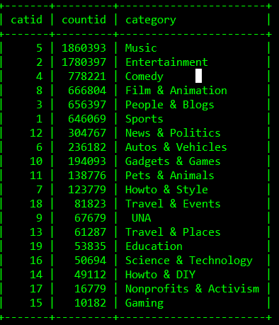
Network Aggregation Solution and Results
Degree Distribution:
For both the node in-degree and out-degree, calculated the average, maximum, and minimum.
Queried the in/out-degree for all nodes in the graph and plotted a histogram to visualize the degree distribution
Categorized Statistics:
Used SQL commands to fetch the the number of videos partitioned by a condition

Slide 7
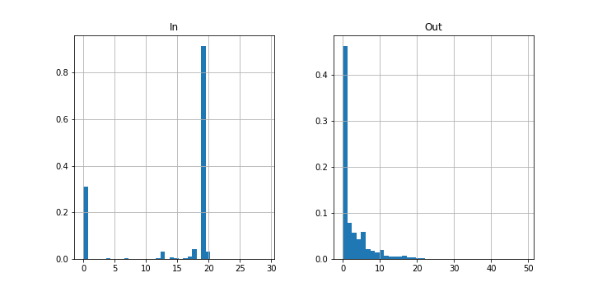

Slide 8
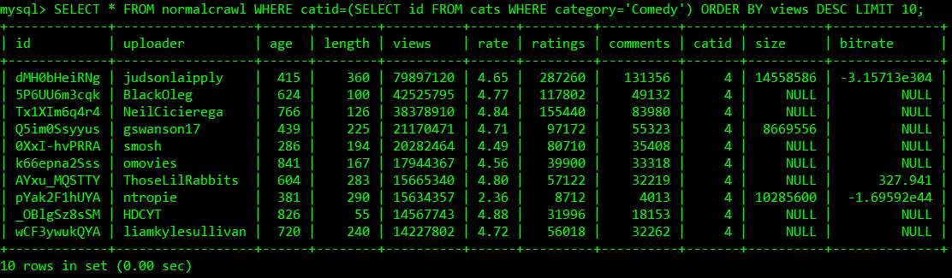
Search Problems Solutions and Results
Normalizing the database
Duplicate entries from the crawl
Keep the latest (views, ratings, comments, etc.)
Combined and separated information
Joined file-size/bitrate table with normal crawl table
Created a new category table for the normal crawl table to reference
Reevaluated data types
Int -> Unsigned Tinyint, Double -> Decimal
Set primary and foreign keys
Set indices

Slide 9
Search Problems Solutions and Results (cont.)
Top-K Queries
Used a simple SQL command on the MySQL database
Example: SELECT * FROM normalcrawl WHERE catid=(SELECT id FROM cats WHERE category='Comedy') ORDER BY views DESC LIMIT 10;
Range Queries
Used a simple SQL command on the MySQL database
Example: SELECT * FROM normalcrawl WHERE catid=(SELECT id FROM cats WHERE category='Entertainment') AND views BETWEEN 10000000 AND 20000000 ORDER BY views DESC;
Recommendation Patterns
Used Neo4j Cypher command to find subpatterns in the graph
Example: MATCH (n) -- (m) WHERE n.ns0__uploader = m.ns0__uploader RETURN n.ns0__uploader, n.ns0__vidID, m.ns0__vidID;

Slide 10
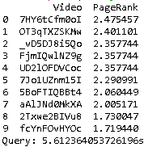
Influence Analysis Solution and Results
Pagerank
A pagerank algorithm was ran on the Neo4j graph
Used a package called Algo to run pagerank
Results:

Slide 11
Demo

Slide 12
;
Questions?

